Slide 1
Supporting Country-driven Innovations and Agri-food Value Chains for Poverty and Hunger Reduction Shenggen Fan Director General | International Food Policy Research Institute
IUFoST 2012
Iguassu Falls | August 9, 2012

Slide 2
Key messages
Hunger, poverty, and undernutrition are still prevalent and future challenges are large and complex
Country-driven innovations must focus on smallholders
Smallholders must be linked to agri-food value chains
Country-level capacity must be strengthened

Slide 3
Poverty, hunger, and undernutrition are still prevalent

Slide 4
Many are still poor around the world
% of population living under $1.25 (2008)
Source: Data from Chen and Ravallion 2012 Note: The size of bubbles represents millions living under $1.25 a day

Slide 5
The majority of poor live in middle-income countries
World poverty by country income group, 2008 ($1.25 poverty line)
 | LICs | MICs | Total
Share of world poverty (%) | 25.7 | 74.3 | 100
Number of poor (millions) | 316.7 | 917.1 | 1233.8
Source: Data from Sumner 2012 Note: LICs and MICs represent low-income countries and middle-income countries
Approximately:
50% live in China and India (esp. in India)
25% live in other MICs (e.g. lower-MICs such as Indonesia, Pakistan and Nigeria)
25% live in LICs

Slide 6
Hunger remains a big challenge
Prevalence of undernourishment 2006-08 (%)
Source: Data from FAO 2012 Note: The size of bubbles represents millions of undernourished people

Slide 7
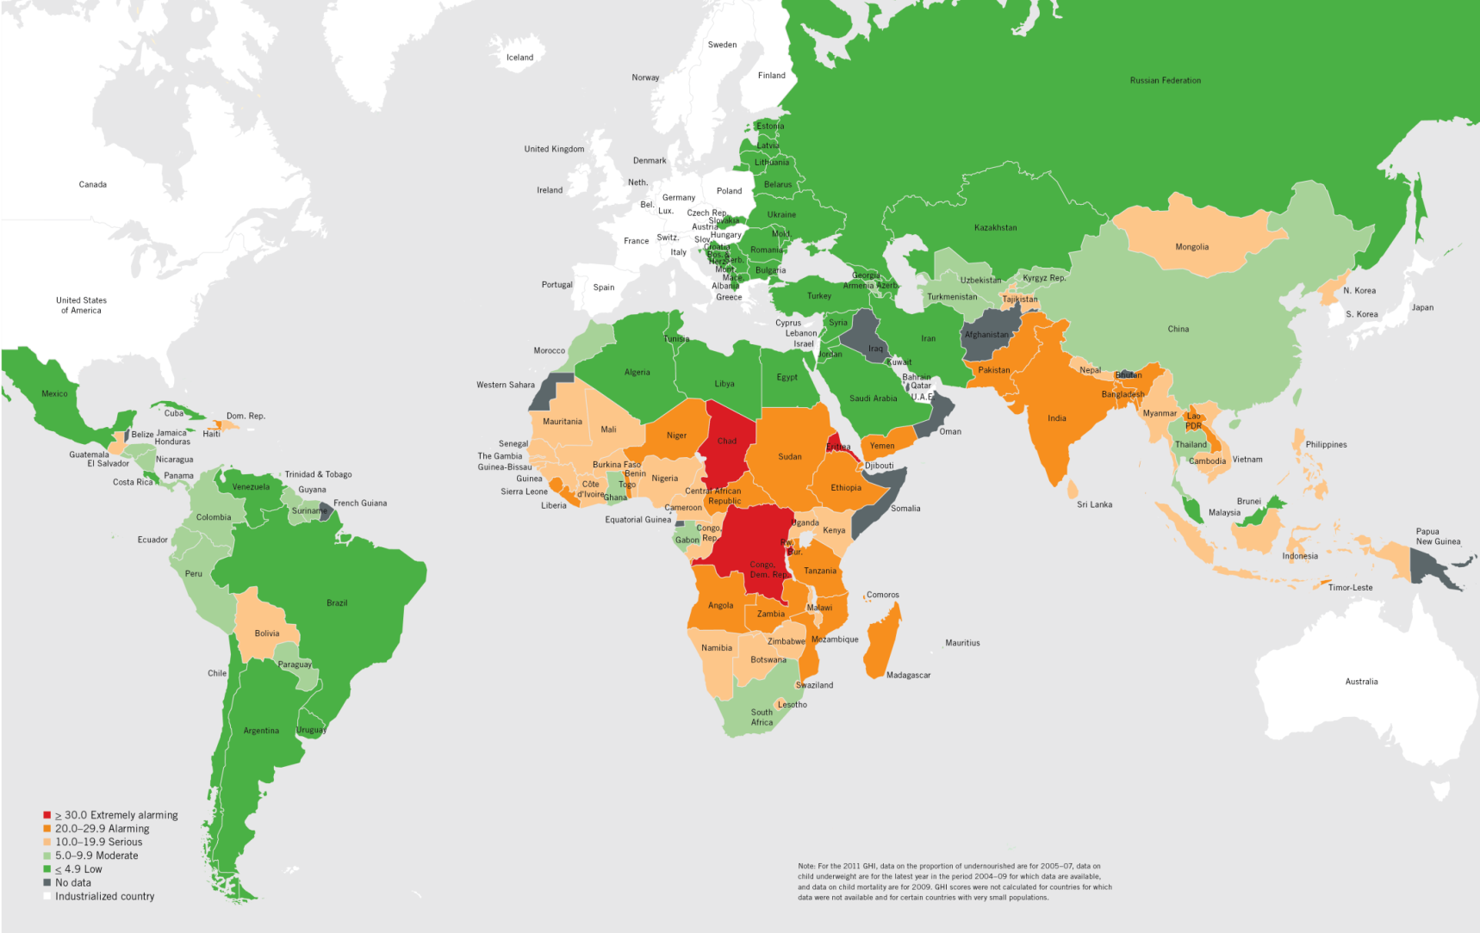
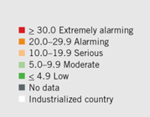
50+ countries have serious / alarming / extremely alarming levels of hunger
2011 Global Hunger Index
GHI components:
Proportion of undernourished
Prevalence of underweight in children
Under-five mortality rate
Source: von Grebmer et al. 2011

Slide 8
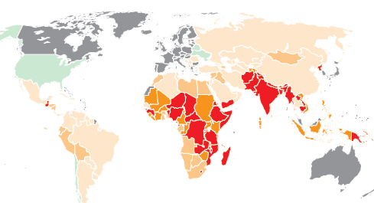
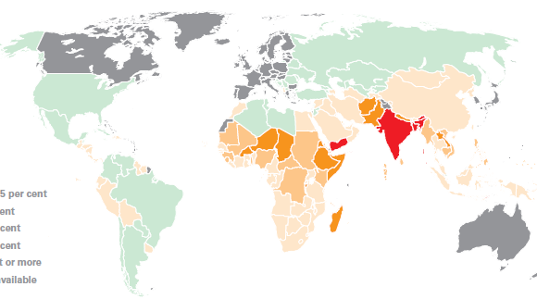
Sub-Saharan Africa and South Asia are hotspots of child undernutrition
Prevalence of stunting in children under 5, 2003-08
Source: UNICEF, 2009
Prevalence of underweight in children under 5, 2003-08

Slide 9
Micronutrient deficiencies remain pervasive
Iron deficiency anemia
Africa and South Asia have the highest prevalence
In some parts of India, 90% of girls suffer from this deficiency
Vitamin A deficiency
163 mil. are vitamin A deficient in developing countries
44.4% of children in South Asia suffer from this deficiency
Iodine deficiency
1.7 bil. people worldwide are affected by iodine deficiency, and 1.3 bil. of them are in Asia
Source: UNSCN 6th Report and Bharati et al. 2009

Slide 10
Future challenges to food and nutrition security are large and complex

Slide 11
Pressures on food and nutrition security
Changing population and demographics
Income growth, rising demand, and diet changes
Natural resource constraints
High and volatile food and energy prices
Climate change and higher frequency/intensity of extreme weather events

Slide 12
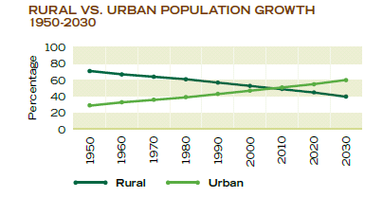
Global population and urbanization continue to rise
Population growth, 1960-2050
Global population projected to surpass 9 billion by 2050
Growth to come primarily from developing countries and urban areas
(United Nations 2011)
Larger and more urban population will demand more and better food
Rural vs. urban population growth, 1960-2050
Source: CropLife International 2010

Slide 13
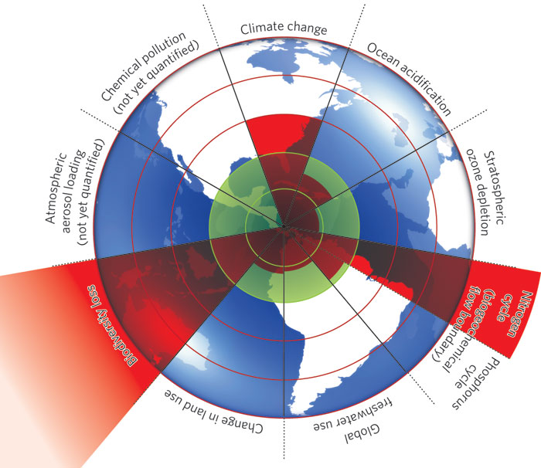
Natural resource limits are being pushed
“Business as usual” may push natural resources faster towards their limits and beyond
Source: Rockström 2011
Notes:
The inner green shading represents the proposed safe operating space for nine planetary systems. The red wedges represent an estimate of the current position for each variable. The boundaries in three systems (rate of biodiversity loss, climate change and human interference with the nitrogen cycle), have already been exceeded.

Slide 14
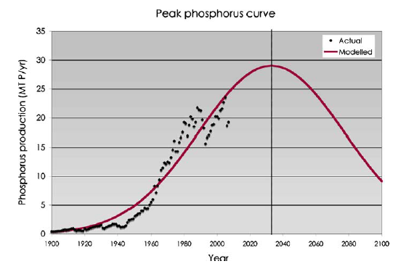
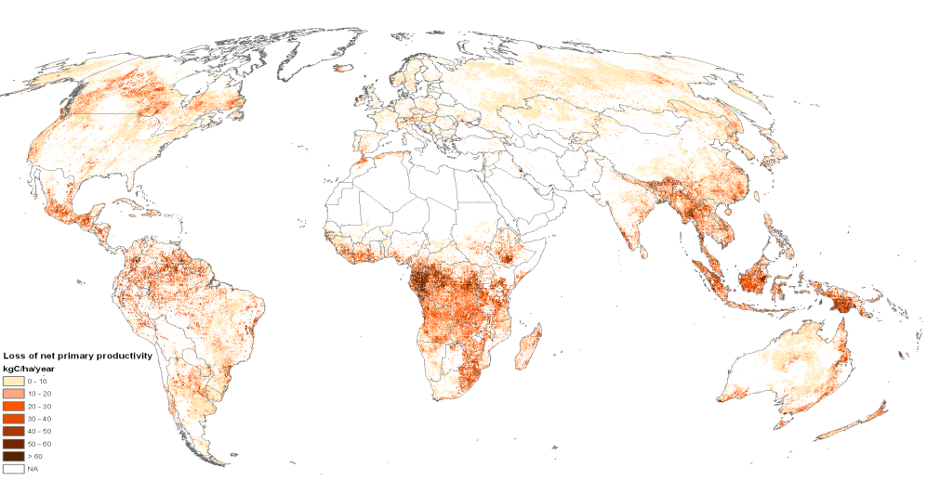
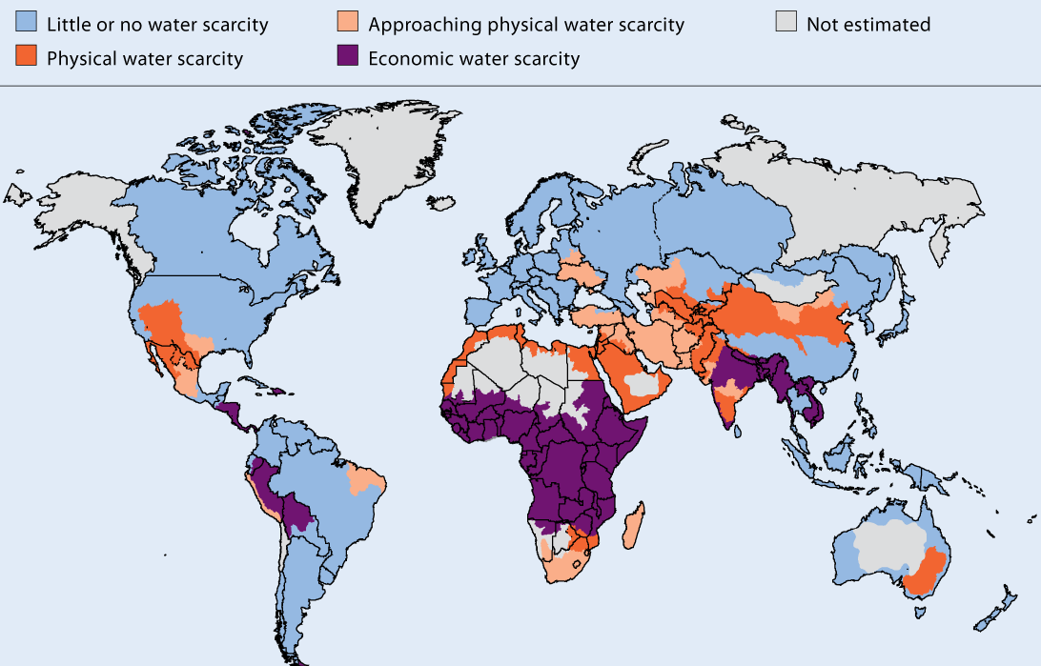
Growing natural resource scarcities threaten food security
Global loss of annual net primary productivity, 1981-2003 (due to degradation)
Peak phosphorus?
Source: Bai et al. 2007 (LADA, FAO/ISRIC)
Source: Cordell et al. 2009
Physical and economic water scarcity
With “business as usual,” high water stress by 2050 puts at risk globally:
52% of population
49% of grain production
45% of GDP
Source: IWMI 2007
Source: Veolia Water and IFPRI 2011

Slide 15
Food prices are high and volatile
FAO food price index
Global cereal prices (US$/ton)
Maize up 24% (since June 2012)
Source: Data from FAO 2012 Note: For Food Price Index 2002-2004=100
Notes:
All time high of 238 points in the FAO food index reached in February 2011
44 million people pushed into poverty between June and December 2010, according to the World Bank

Slide 16
Ongoing US drought could affect prices in developing countries
US maize & soybean prices (US$/ton)
Higher prices in domestic markets can transmit to global (and vice versa)
US is top producer and exporter of maize and soybeans
Share of global production: > 30%
Share of global exports: > 40%
75% of global prices were transmitted to African prices in 2007-08 (Minot 2011)
Degree of transmission depends on several factors e.g. trade polices
Source: Data from FAO 2012

Slide 17
High and volatile food prices hurt poor consumers
Self-reported food insecurity, SSA
During 2007-08 crisis
Ethiopia: More female-headed hhs suffered from food shortages—67% compared to 58% of male-headed hhs (Kumar and Quisumbing 2011)
Ecuador, Haiti, Nicaragua, Panama, and Peru: Reduction in calorie intake (0.95% – 15%) (Robles and Iannotti 2011)
Source: Headey 2011

Slide 18
Climate change will food prices and calorie consumption
International food prices (2010=100)
Source: IFPRI 2011
Notes:
Prices: Average of four GCM, A1B, A2 ,B1, B2 Scenarios

Slide 19
Smallholder agriculture offers opportunities for achieving food and nutrition security

Slide 20
Is small beautiful?
The answer is: It depends
Marginal returns to rural labor must = marginal returns to urban labor (adjusting for labor quality)
Emerging countries: Rapid urbanization and rural-urban migration may provide opportunity to increase in farm size
Africa and South Asia: Continued rural population growth will lead to decline in farm size
Institutional barriers to labor movement between sectors must be removed
Notes:
In the long run, majority of rural labor should eventually move out of agriculture to urban centers/non-farm jobs.

Slide 21
So small farmers matter
Source: Farming First 2012
Provide up to 80% of food supply in Asia and Sub-Saharan Africa (FAO 2012)
BUT represent bulk of world’s poor and 50% of world’s hungry (Hazell et al. 2007)

Slide 22
The share of small farms is large
Farm size (ha) | % of all farms
 | Africa | Asia
<2 | 80 | 89
2-10 | 15 | 10
10-100 | 3 | 1
>100 | 0 | 0
Source: Data from FAO Agricultural World Census from late 1980s-2000s
Higher productivity of small farms = agricultural and overall economic growth
Notes:
Majority of poor and hungry are smallholders
Smallholders account for about 60-80% of global food production

Slide 23
Small farms offer opportunities…
Use land more efficiently
Absence of economies of scale in most types of farming, e.g. due to cost of labor supervision
Improve food security by providing cheap, locally-produced food in areas with high transport costs
Generate demand for goods and services, thereby stimulating rural non-farm economy
Create additional jobs
Promote hunger and poverty reduction and equity
Source: Hazell et al. 2007
Notes:
“inverse relationship” between farm size and production per unit of land.

Slide 24
…but they also face many challenges
Limited resources (e.g. land, financial and human capital)
Insufficient access to technology, markets, credit, and infrastructure
High marketing and transport costs
Vulnerable to shocks
Supply chains with higher requirements for quality, safety, and traceability (e.g. supermarkets)
International competition as a result of more open markets
Policy bias towards larger farms
Climate change and environmental degradation

Slide 25
Country-driven innovations must focus on smallholders

Slide 26
Improve smallholder productivity
Invest in agric. R&D and rural infrastructure
Improve access to inputs
Promote innovations in finance, insurance, and institutions

Slide 27
Investment in agric. R&D has higher returns
 | Ghana | Uganda | Tanzania | Ethiopia | China |  | India |  | Thailand
 | Returns to agriculture or rural income (local currency/local currency spending)
Agric. R&D | 16.8 | 12.4 | 12.5 | 0.14 | 6.8 |  | 13.5 |  | 12.6
Education | -0.2 | 7.2 | 9.0 | 0.56 | 2.2 |  | 1.4 |  | 2.1
Health | 1.3 | 0.9 | n.e. | -0.03 | n.e. |  | 0.8 |  | n.e.
Roads | 8.8 | 2.7 | 9.1 | 4.22 | 1.7 |  | 5.3 |  | 0.9
 | Ranking in returns to poverty reduction
Agric. R&D | n.e. | 1 | 2 | n.e. |  | 2 | 2 | 1
Education | n.e. | 3 | 1 | n.e. |  | 1 | 3 | 3
Health | n.e. | 4 | n.e. | n.e. |  | n.e. | 4 | n.e.
Roads | n.e. | 2 | 3 | n.e. |  | 3 | 1 | 2
Source: Fan, Mogues, and Benin 2009 Note: “n.e.” indicates not estimated

Slide 28
Investments in new technologies have high pay-offs
Smallholder cassava production, Nigeria
Improved cassava varieties, advances in pest control, processing technology, mid 1980s-early 1990s
Tripled production in less than a decade
Farmer net profits were 18 times higher
Returns to labor increased by > 60%
Increased income and gender equity
Generated significant technology spillovers to Ghana
Source: Nweke and Haggblade 2010

Slide 29
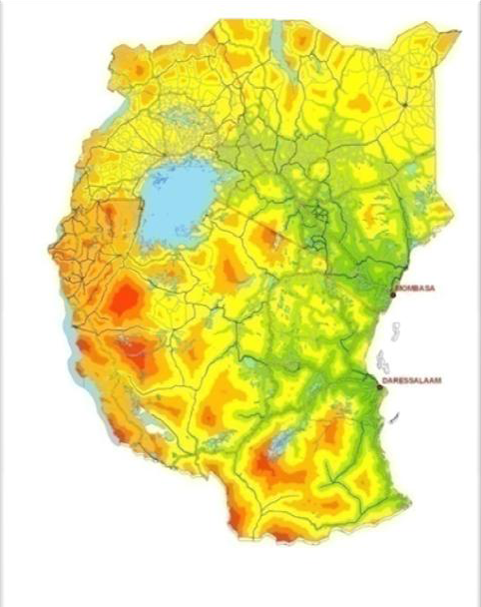
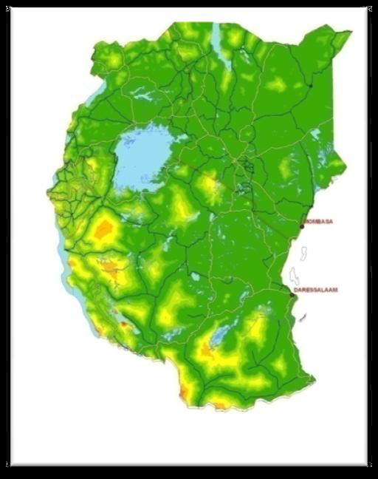
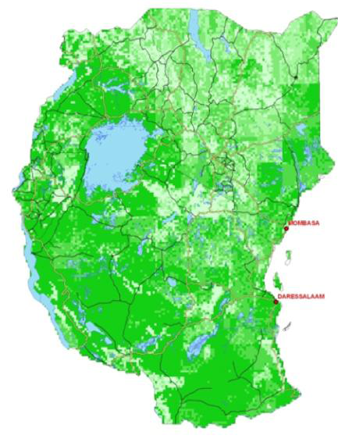
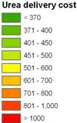
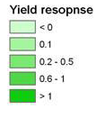
Improved access to inputs can raise smallholder productivity
Baseline: High urea delivery cost
Lower urea delivery cost
Maize yield response
More affordable fertilizer leads to higher crop yields
Source: Guo et al. 2009

Slide 30
Promote smallholder-friendly innovations
Finance - Kloeppinger-Todd and Sharma 2010
Modern communication technology e.g. cell phone-based payment services
Financial and non-financial service bundles e.g. livestock health monitoring and credit
Insurance - Vargas Hill and Torero 2009
Weather index-based insurance
Microfinance and microinsurance bundles
Institutions - Asenso-Okyere et al. 2008
Producer cooperatives; contract farming
Social and rural knowledge networks

Slide 31
Smallholders must be linked to agri-food value chains

Slide 32
Transformation of supply chains offer opportunities
Agrifood industry transformed along entire supply chain:
Socioeconomic factors, e.g. income growth / urbanization
Policy reforms, e.g. market liberalization / privatization
Emergence of supermarkets and large wholesalers / processors
Higher quality supply chains
Integration of smallholders into modern supply chains yields positive impacts (Reardon et al. 2009)
Notes:
(1) Supermarkets early-on best traditional retailers by charging lower prices for processed
products—taking advantage of procurement systems that allow economies of
scale. The poor consumers take advantage of this to buy processed foods and
semi-processed foods from supermarkets. (2) Supermarkets early-on sell

Slide 33
India: Linking smallholders to dairy grid
Linked small dairy producers to urban consumers
Chain of production, procurement, processing, and marketing
Created national milk grid of village cooperatives, district unions, and state marketing federations
13 mil. participants, 3.7 mil. women in 2008
Dairy production rose by 4.5% per yr,1970-2001
(Cunningham 2009)
Increase bargaining power; provide demand information; and reduce transaction costs and risks

Slide 34
More on innovative agri-food chains
Author | Type | Innovation | Region/ Country | Actual / potential beneficiaries and impact
Saenger et al. 2012 | Dairy | Contract farming | Vietnam | Small farmers and processors Higher productivity Better milk quality with quality-dependent pricing Lower per-unit transaction costs with independent quality control
Chenevix Trench et al. 2011 | Perishable foods | Modified risk analysis framework | General | Poor small farmers and consumers Higher incomes from producing high-value foods Lower health risk
Hawkes & Ruel 2011 | Multiple incl. fortified foods | Nutrition-sensitive chains | Developing countries | Poor and marginal popula­tions Better nutrition Improved access to nutritious foods (availability, affordability, and acceptability)
Bernard & Spiel­man 2009 | Grains | Producer coop­eratives | Ethiopia | Smallholders Positive spill­overs from cooperative activities

Slide 35
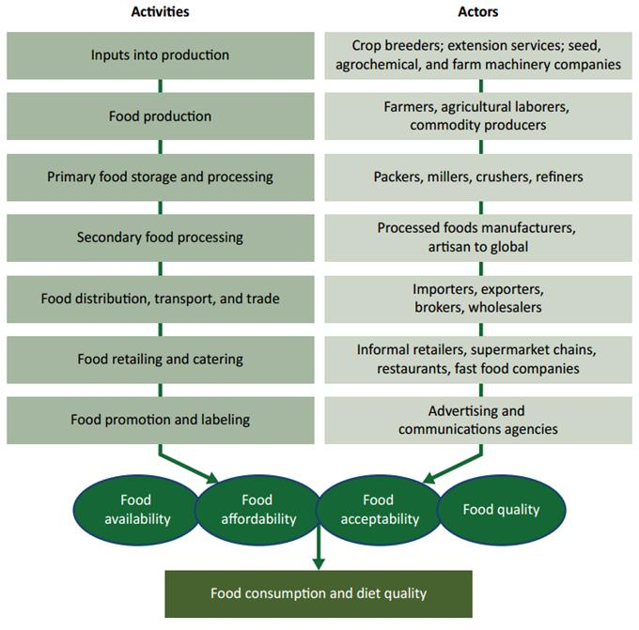
Value chain approaches are important for achieving nutrition goals
Food supply chain
Nutrition-sensitive value chains can:
boost supply of accessible nutritious foods
raise demand for and acceptability of nutritious foods
Increase coordination among value-chain actors and activities
address trade-offs between economic returns and nutritional benefits of agriculture
Source: Hawkes and Ruel 2011

Slide 36
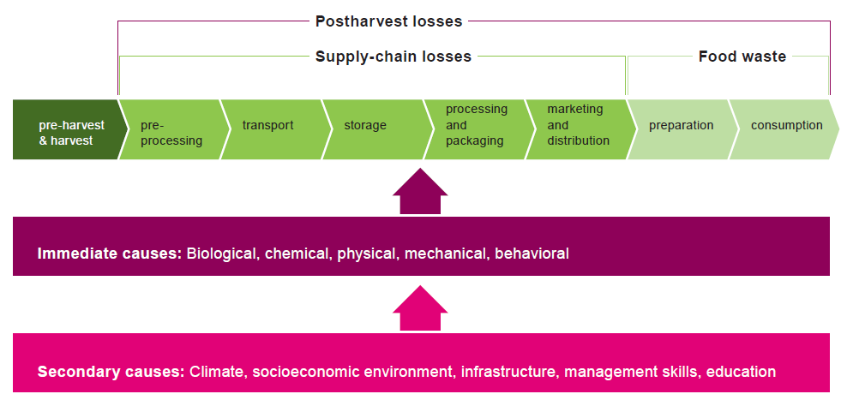
BUT postharvest losses are still large
Source: Grethe et al. 2011
~ 30% of global food produced is lost / wasted annually (FAO 2011)

Slide 37
Food losses are big in developing countries…
Mainly at the production level
Causes e.g.
Poor postharvest handling practices, drying techniques, and moisture levels
Insufficient storage
Infestation by micro-organisms, insects, rodents, etc.
Lack of infrastructure e.g. cold chains and transportation (FAO 2011)
Weeds, pathogens, and animal pests alone can cause losses of up to 40% (Oerke 2006)
SSA: Post-harvest grain losses = ~ US$4 bil. / yr = food requirements of 48 mil. people (World Bank 2011)

Slide 38
…while food waste is high in developed countries
Mainly at the retailer and consumer levels
Causes e.g.
Retailer level: consumer behavior, quality regulations, retail practices, poor coordination among supply chain actors
Consumer level: poor purchase planning, expiring “best-before-dates”, careless consumer attitude (FAO 2011)
US food waste: 1400 kcal / person / day =
= 25% of freshwater consumption and 300 million barrels of oil / yr (Hall et al. 2009)

Slide 39
Reducing losses and waste along the value chain is important
Developing country needs
Investments in
Infrastructure and technology e.g. storage, cold chains, transportation, electricity, and communication
Post-harvest handling e.g. drying, cleaning, grading, and packing
Capacity building for farmers and traders
Enabling environment and institutional framework
Food losses and waste have significant implications for poverty and hunger reduction
Source: FAO 2011

Slide 40
Country-level capacity must be strengthened

Slide 41
Promote country-owned, evidence-based strategies and policies
Policies should come from developing countries to maximize local impact of global agenda
Improve evidence on what policies have and have not worked
Small-scale, local experimentation followed by gradual implementation, e.g. China and Vietnam
Impartial monitoring of experiments
Country-owned policies should be continually tried, evaluated, adjusted, and tried again before being scaled up

Slide 42
Capacity building needed, esp. in Africa
Lack of reliable data
Weak capacity in policymaking and strategy formulation
Weak capacity in setting investment priorities and designing investment plans
Lack of research support for policy (from universities, think tanks, etc.)
Absence of a M&E system

Slide 43
Building capacities in Africa
Support for CAADP
Provide analysis, data, and tools for evidence-based decision making
Improve awareness of role or agriculture
Fill knowledge gaps
Promote dialogue
Facilitate benchmarking and review processes
Promote access to and use of state-of-the art modeling tools
Facilitate access to data, improve data quality, bridge data gaps
Support collaboration among leading African scientists
Build dynamic research community that can respond to needs of CAADP’s agenda

Slide 44
Building capacities to improve value-chains
B20 Task Force recommendations
Promote policies to catalyze, de-risk, and offer incentives for private-sector investment in food-value chains
Invest in supporting growth and innovation along value chains (private sector with support of governments)
Invest in training of farmers, entrepreneurs, and specialists along food-value chain

Slide 45
In conclusion
Scale-up investments to
increase agricultural productivity
reduce food losses and waste along the value-chain
improve nutrition
Focus on smallholders, but be context specific
Most importantly—support country-led innovations and development agenda

